Slide 1
GT (A Generalization of Transformer Networks to Graphs)
2021
DLG-AAAI
AAAI 2021 Workshop on Deep Learning on Graphs: Methods and Applications
Code https://github.com/graphdeeplearning/graphtransformer
Speaker: Tianpu Zhang

Slide 2
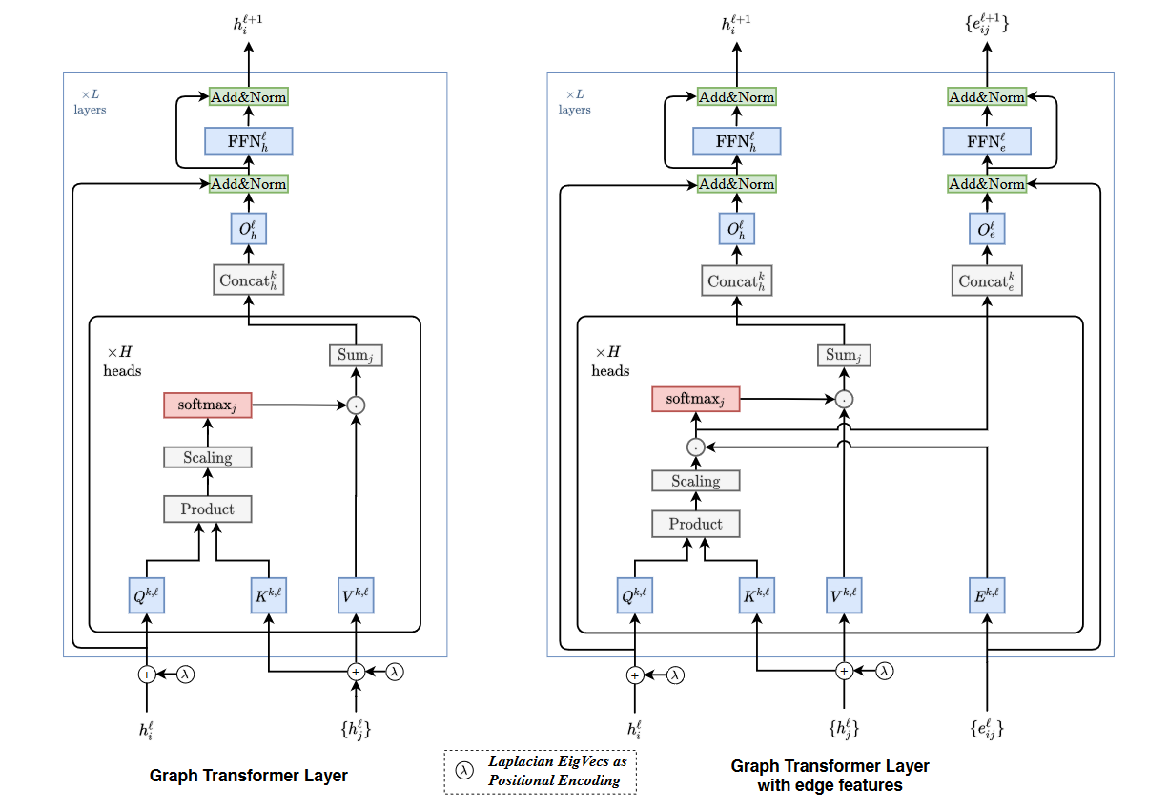
Overview

Slide 3



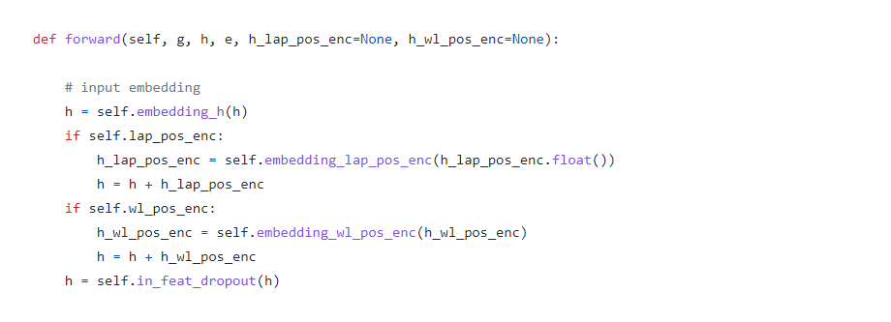
Input
Node Feature
Edge Feature
Linear Projection
Node Positional Encodings

Slide 4

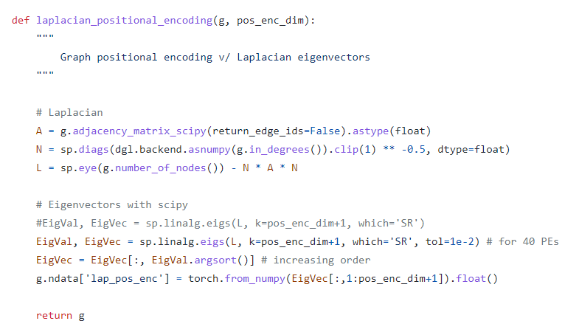
Node Positional Encodings
We use the k smallest non-trivial eigenvectors of a node as its positional encoding and denote by λi for node i.

Slide 5
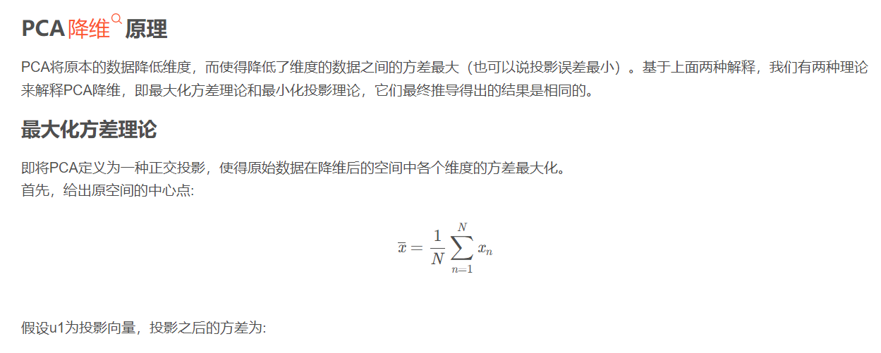

PCA
Reference: https://blog.csdn.net/zgcr654321/article/details/88365695

Slide 6
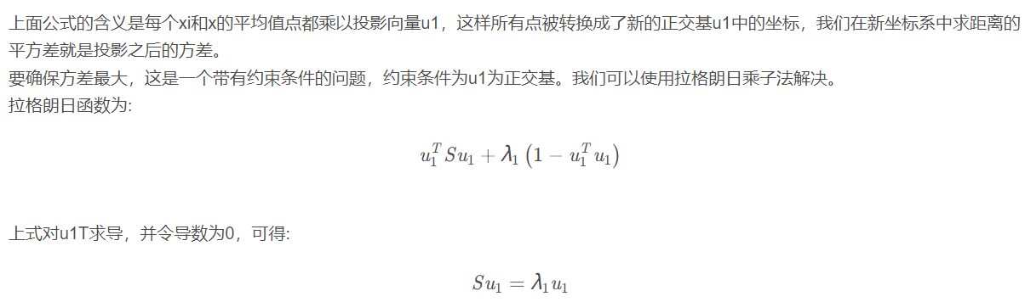
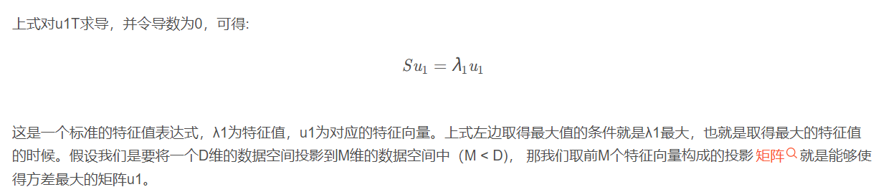
PCA

Slide 7

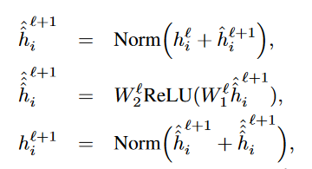

Graph Transformer Layer

Slide 8
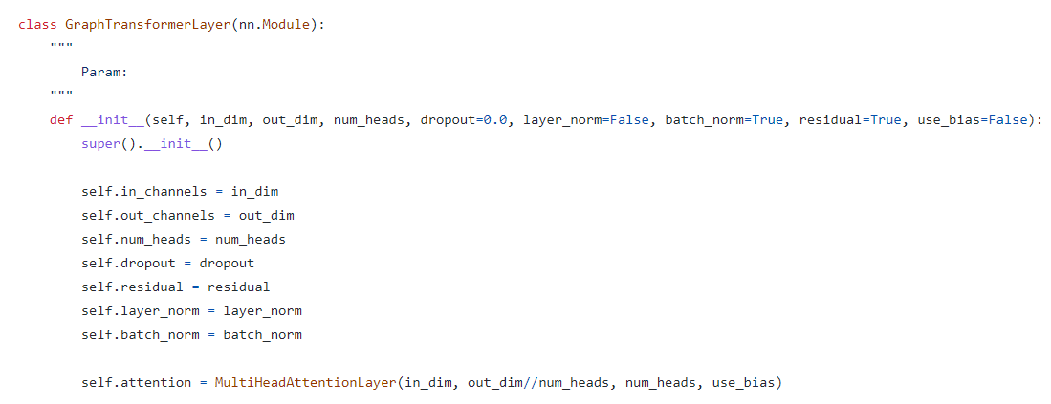
Multi-head Attention

Slide 9
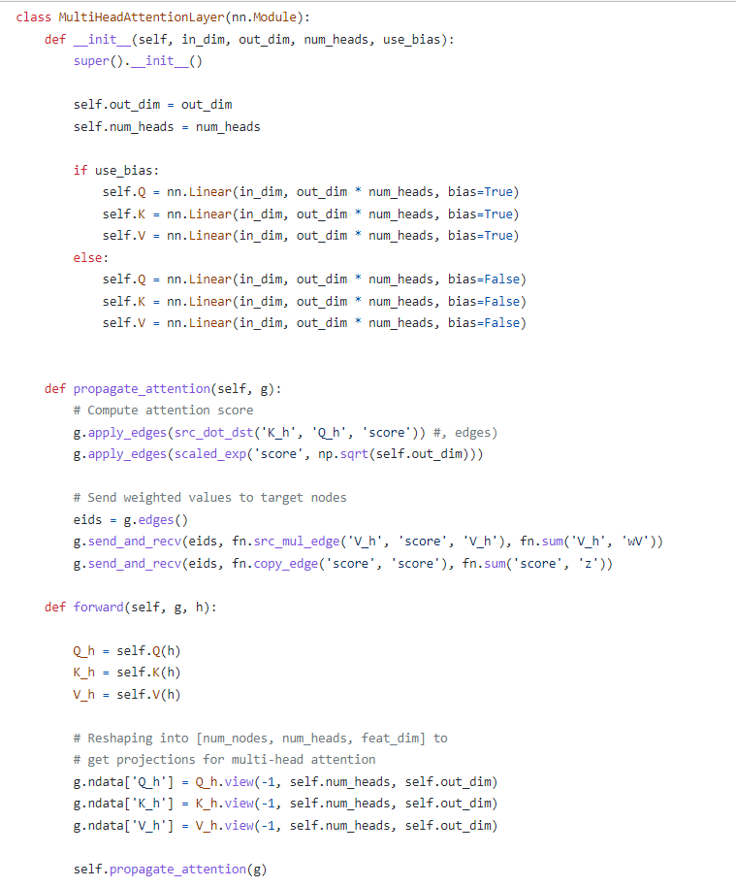
Multi-head Attention

Slide 10
Experiments
Dataset
ZINC, Graph Regression
MAE
PATTERN, Node Classification
ACC
CLUSTER, Node Classification
ACC

Slide 11
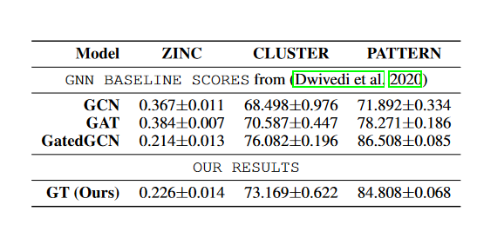
Experiments
Comparison of our best performing scores on each dataset against the GNN baselines (GCN (Kipf and Welling 2017), GAT (Veliˇ ckovi ́ c et al. 2018), GatedGCN(Bresson and Laurent 2017)) of 500k model parameters. Note: Only GatedGCN and GT models use the available edge attributes in ZINC.
Bresson, X.; and Laurent, T. 2017. Residual gated graph convnets. arXiv preprint arXiv:1711.07553 .

Slide 12
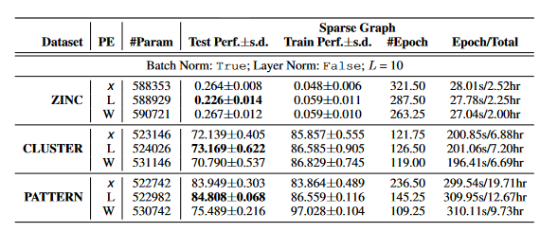
Experiments
Analysis of GraphTransformer (GT) using different PE schemes. Notations x: No PE; L: LapPE (ours); W: WLPE (Zhang et al. 2020). Bold: the best performing model for each dataset.
Zhang, J.; Zhang, H.; Sun, L.; and Xia, C. 2020. Graph-Bert: Only Attention is Needed for Learning Graph Representations. arXiv preprint arXiv:2001.05140 .

Slide 13
Advantage
A novel positional embedding method was proposed to present the relative relationship of nodes in the Transformer

Slide 14
END
Thank you

